Slide 1

Price Action & Time Frame Analysis
BRIGHT RIKIN
CAPITAL MARKET ANALYST AT PIPRAISERS

Slide 2
Objectives
Develop Trading Strategy using Trendline, Support & Resistance, Breakout,
Breakdown and Candle Stick Patterns, Chart Patterns, Flag patterns, and Time Zone Analysis

Slide 3
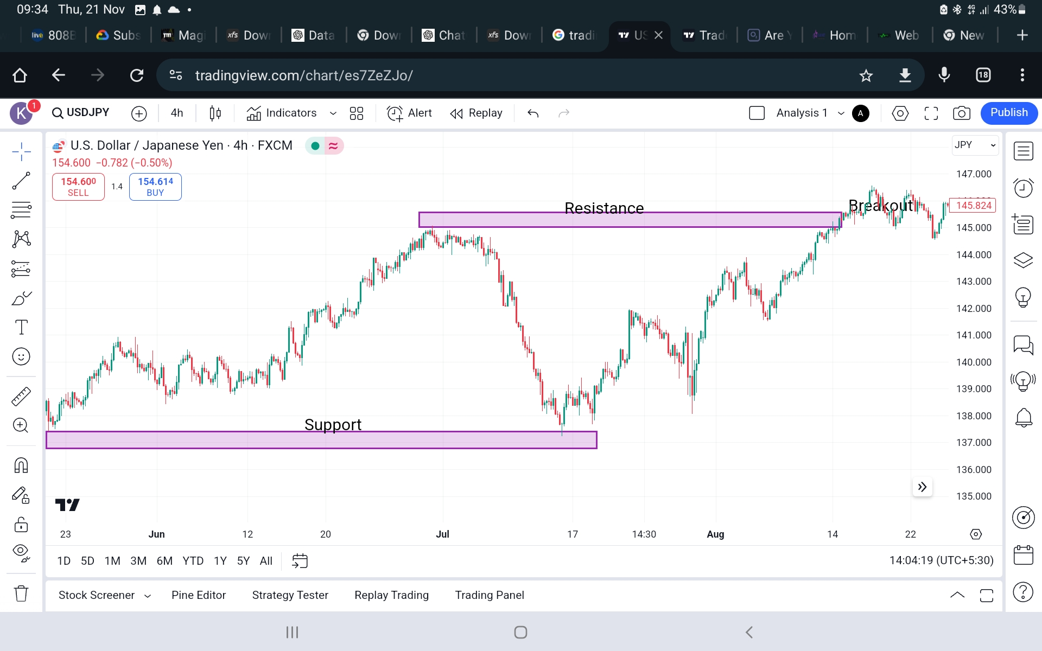
Support & Resistance

Slide 4
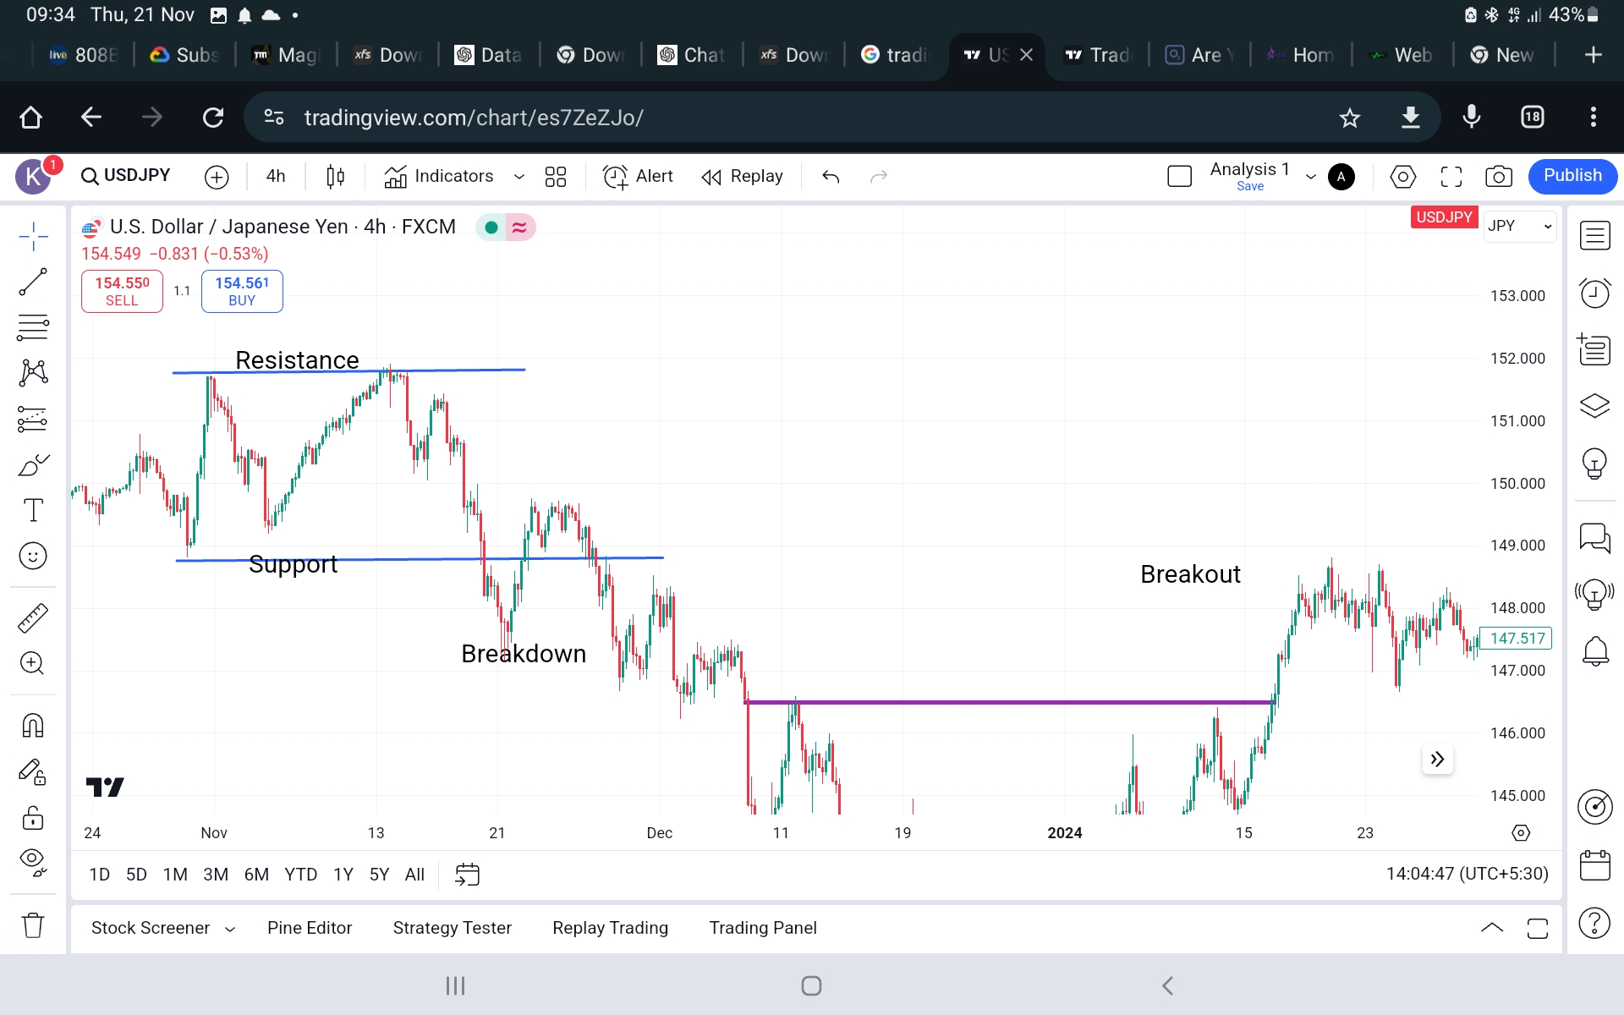
Support & Resistance

Slide 5
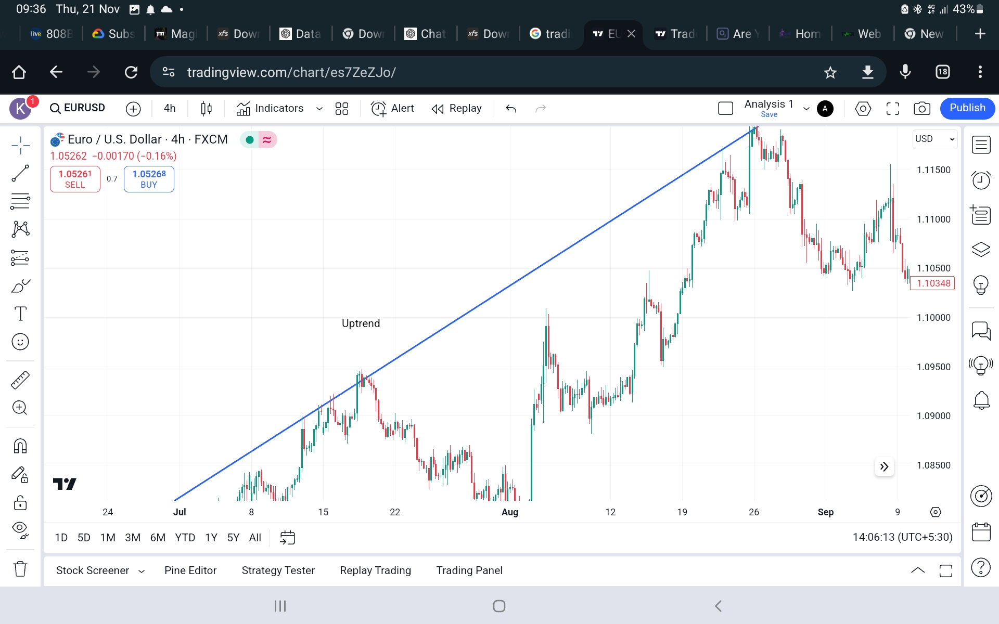
Trendlines & Bullish Pattern

Slide 6
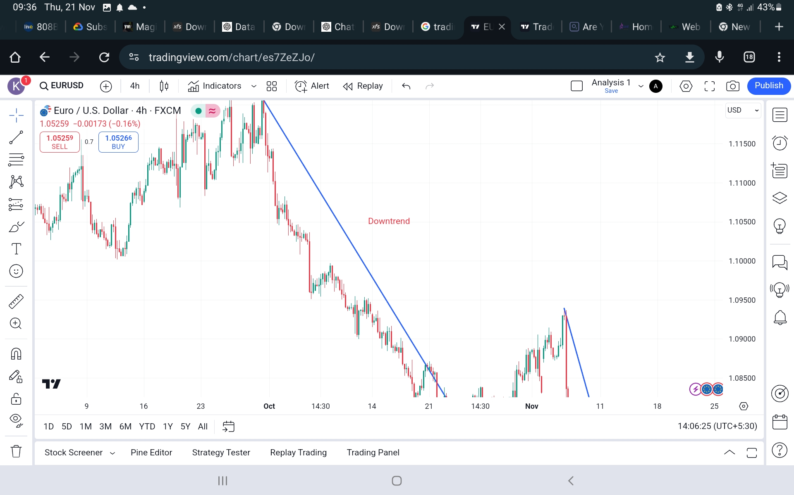
Trendlines

Slide 7
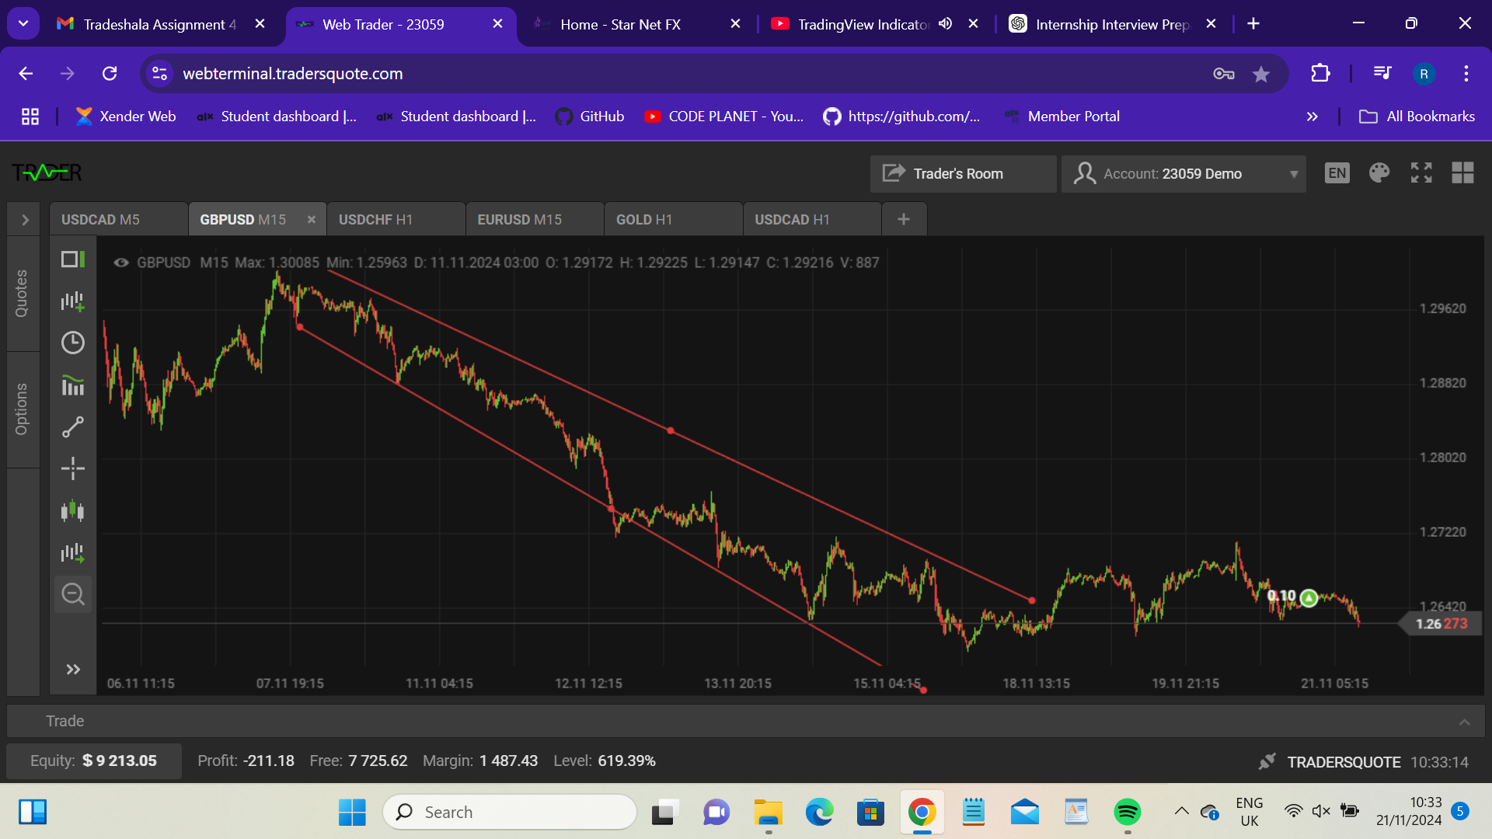
Trendlines & Bearish Patterns

Slide 8
Breakout & Breakdown

Slide 9
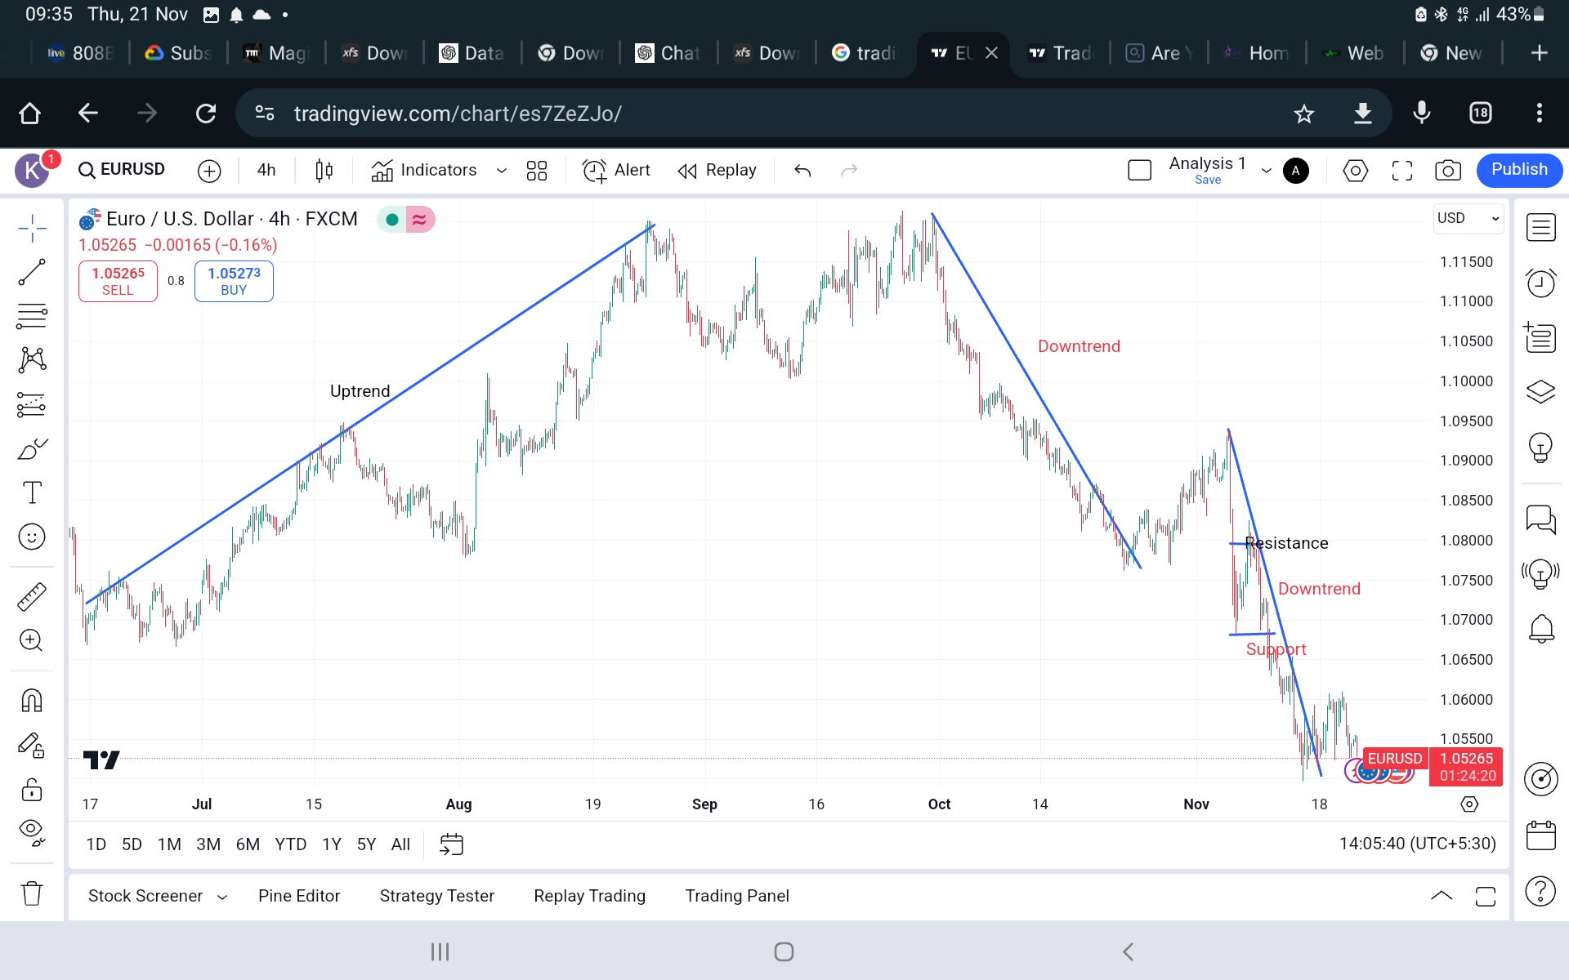
Breakout & Breakdown

Slide 10
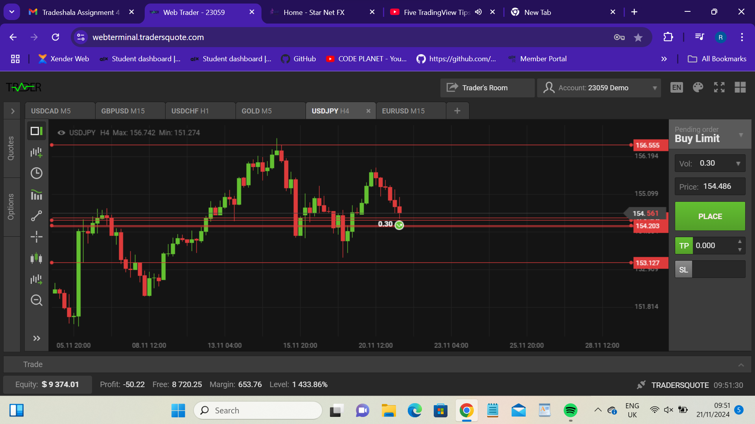
Candle stick pattern

Slide 11
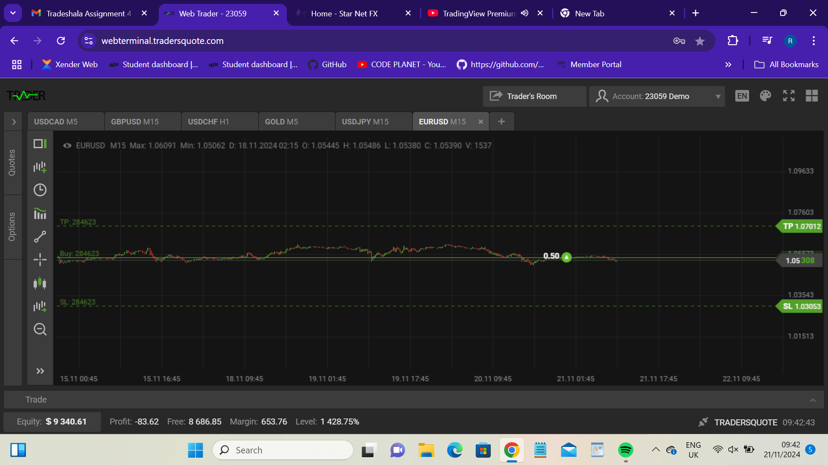
Market Entry, TP, SL Support

Slide 12
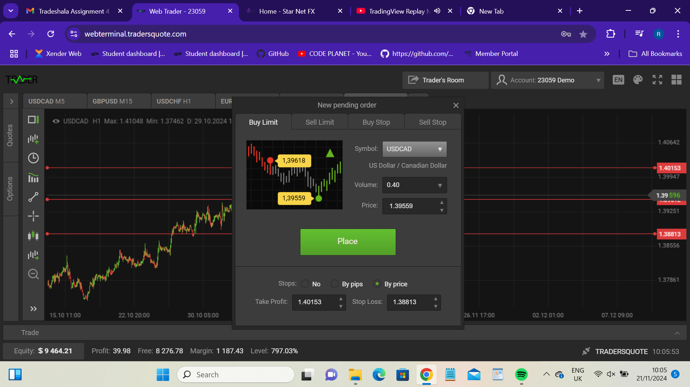
More Market Positions

Slide 13
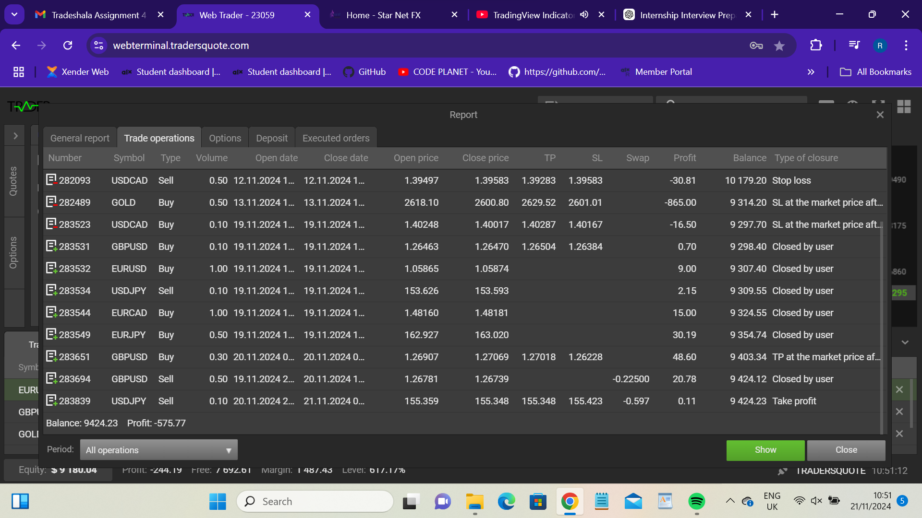
Trade Samples

Slide 14
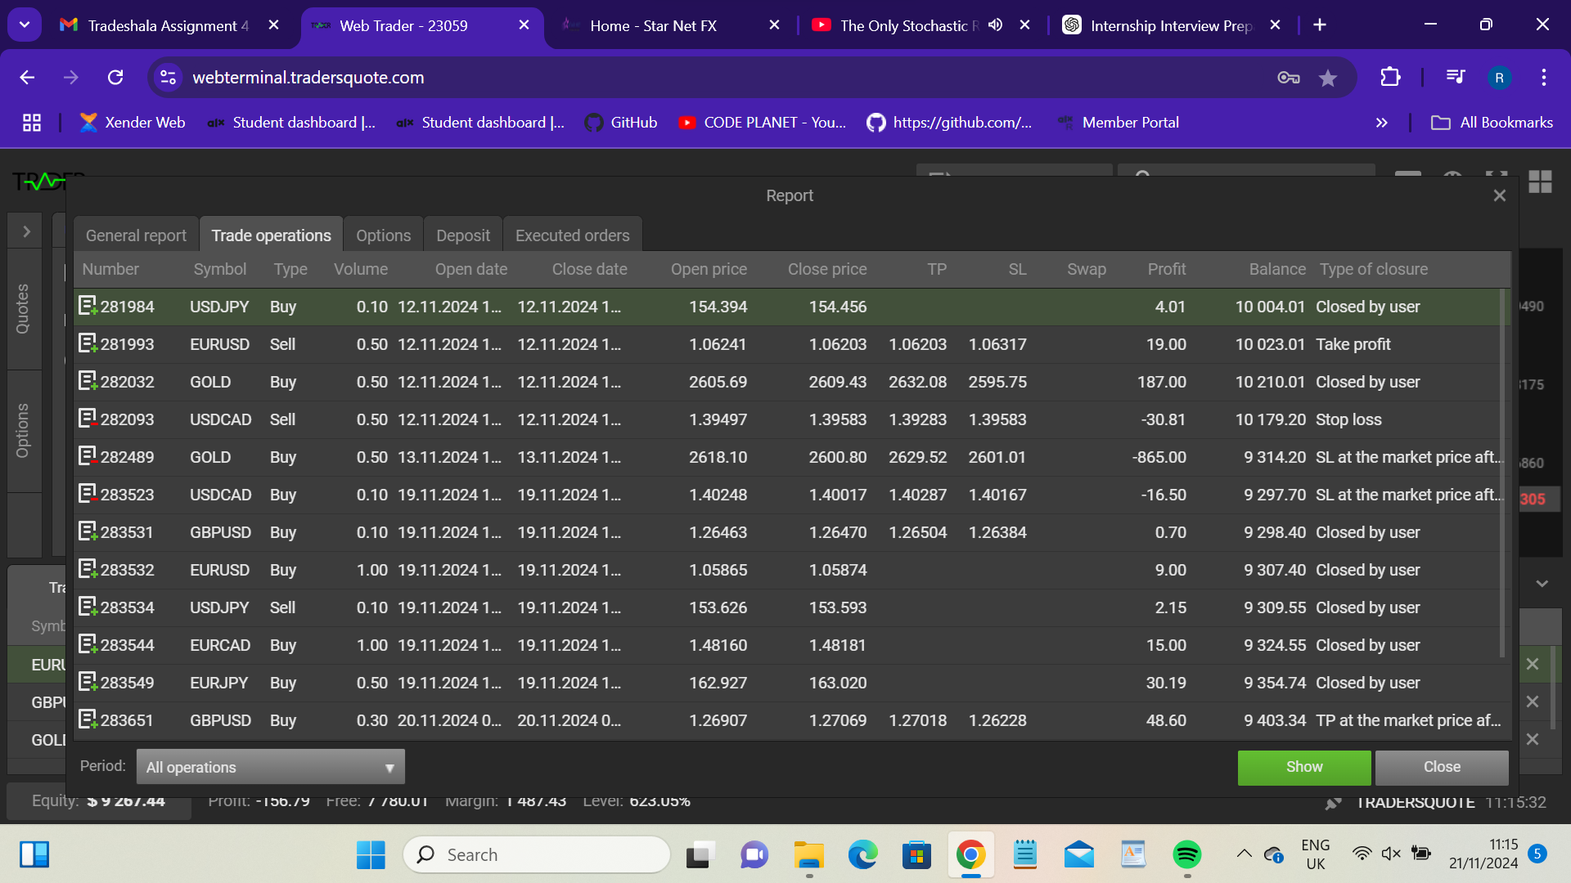
More Trade Samples

Slide 15
Calculate Profit/Loss
Calculate profit/loss using 0.1 volume and $1000 Equity.
Profit/loss = (Exit price – Entry Price)* Contract size * volume.
ROI%= (Net profit or loss/Equity) * 100

Slide 16
Calculations
1. GBPUSD -> Sell
Vol = 0.5
Open price= 1.26781
Close price= 1.26739
Profit= $20.78
ROI= 20.78/1000 * 100 =2.078%

Slide 17
Calculations
EURJPY ->
Vol= 0.5
Open price= 162.927
Close price= 163.020
Profit = 30.19
ROI= 30.19/1000 * 100 =3.02%

Slide 18
Calculations
USDJPY -> Sell
Vol= 0.1
Open price= 153.626
Close price= 153.593
Profit= 2.15
ROI= 2.15/1000 * 100 = 0.215%

Slide 19
Calculations
GOLD -> Buy
Vol= 0.5
Open price= 2618.10
Close price= 2600.80
TP= 2629.52, SL= 2601.01
Loss= -865.00 SL at market price
ROL= -865/10000 * 100= -8.65%

Slide 20
Recommendations
Use Multiple Timeframes:
Analyze charts in various timeframes to confirm patterns and levels before entering trades.
Combine lower timeframes (for entries) with higher ones (for context).
Focus on Pattern Confirmation:
Always wait for confirmation before acting on breakouts, breakdowns, or candlestick patterns.
For example, a bullish engulfing pattern near support becomes more reliable if followed
by a strong upward candle.
Diversify Across Asset Classes:
Trade a mix of asset classes to mitigate risks. While equities provide growth opportunities,
forex and commodities often react to macroeconomic events differently.
Maintain Risk Management:
Limit exposure to a single trade to 1-2% of equity.
Set stop-loss orders to protect capital and adhere to them without exceptions.
Learn and Adapt:
Backtest strategies to understand historical performance and refine them regularly.
Stay updated with market news to anticipate potential price movements.

Slide 21
Conclusion
Thankyou

